Slide 1

Detroit Temperature Control and Downstream passage
Jeff Ament, PM
Kristy Fortuny, TL
Jon Rerecich, Fish Biologist
Steve Schlenker, Hydraulic Engineer
23 January 2018

Slide 2
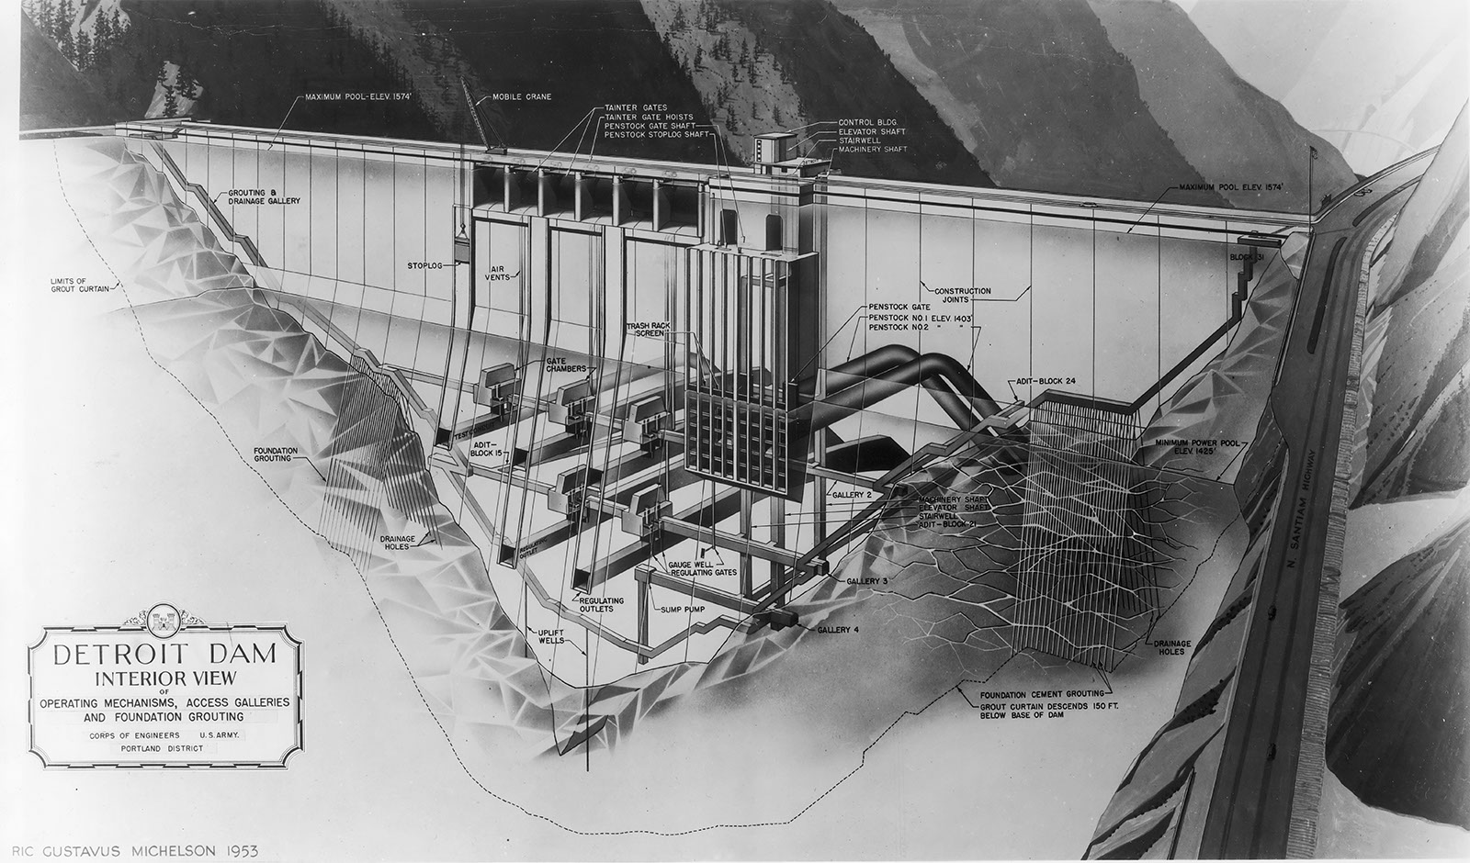
Agenda
Weir Box Update
Schedule
60% SWS DDR Update

Slide 3
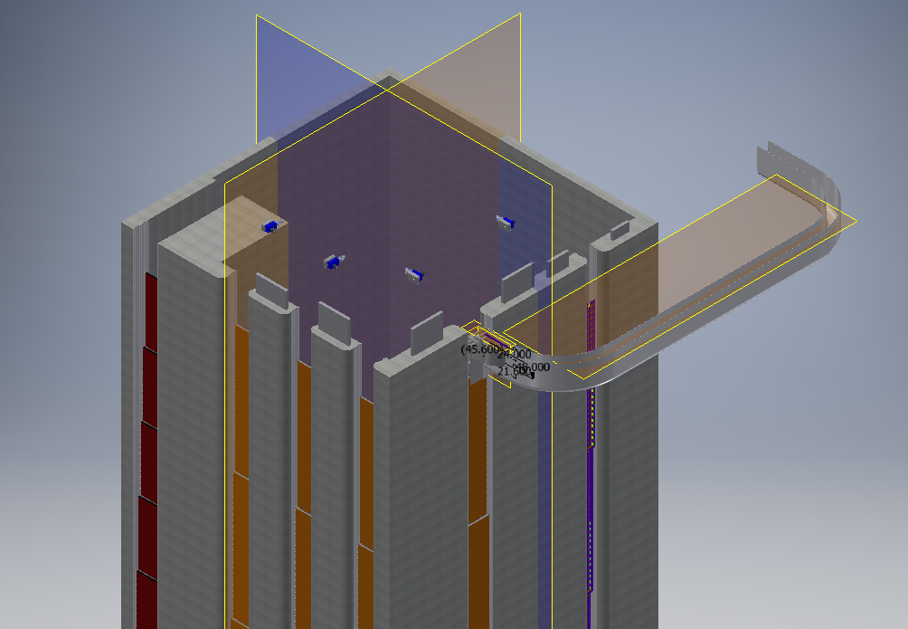
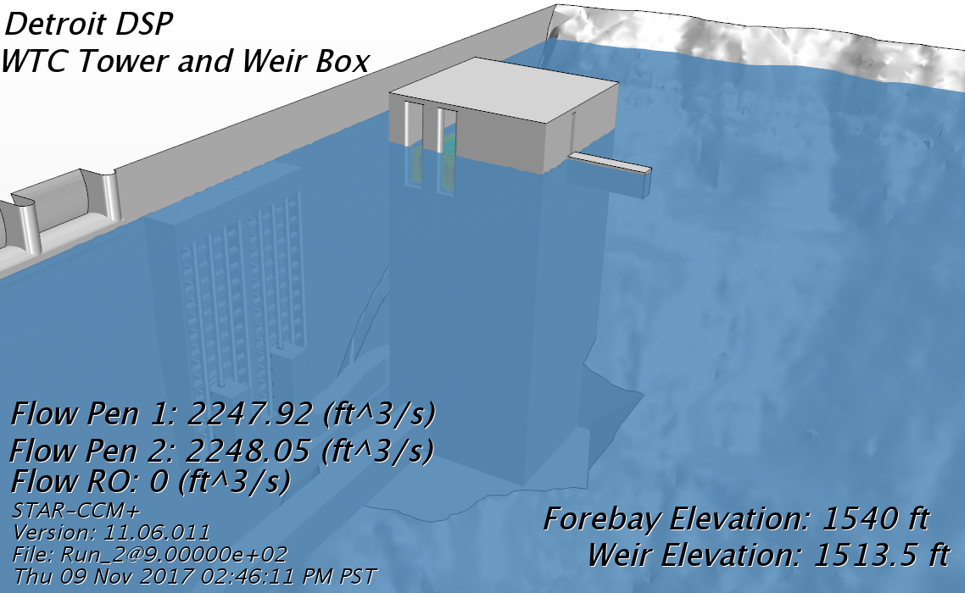
Weir Box Concerns/Risk
Collection efficiency
Increased wet well size
Hydraulic conditions inside wet well

Slide 4
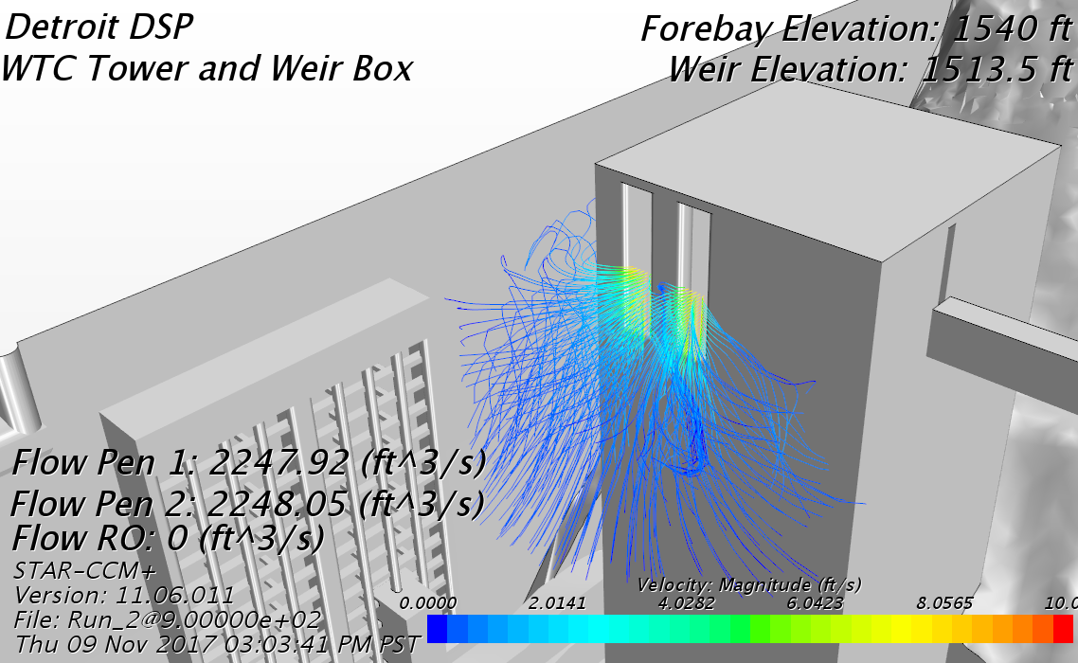
Tower with Weir Box

Slide 5
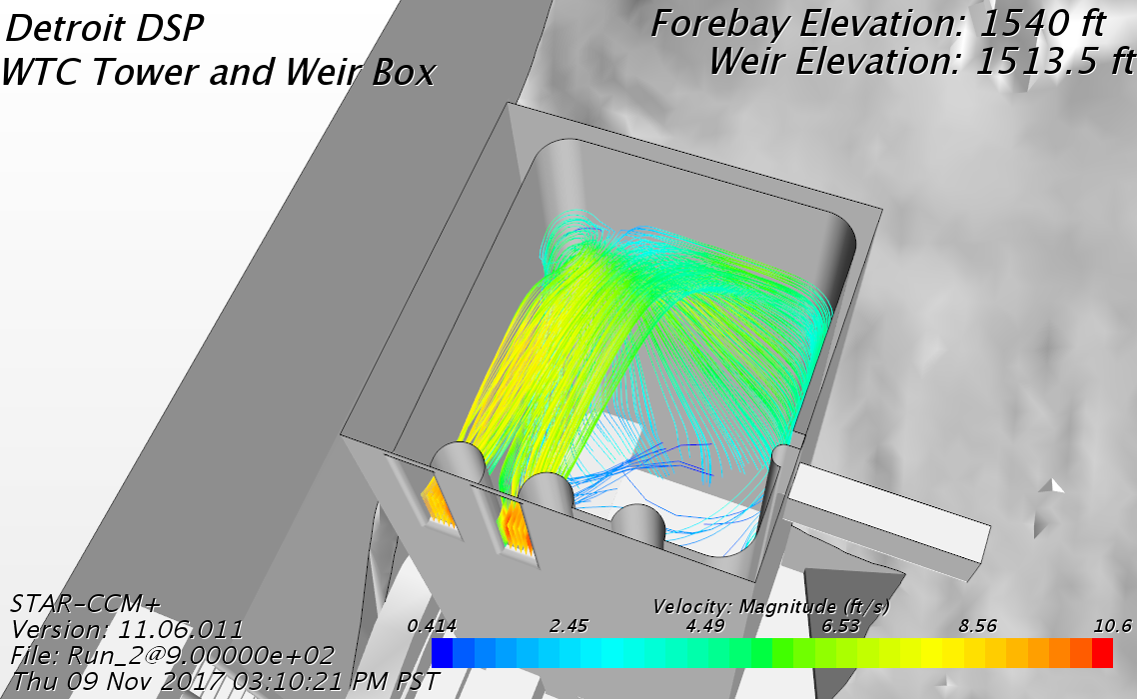
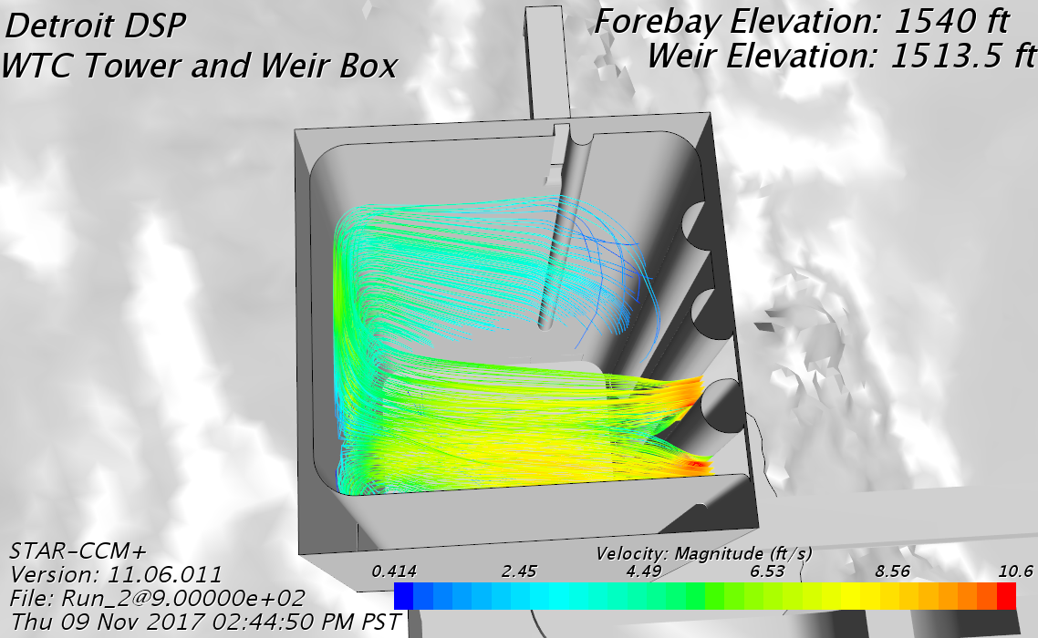
Water particles entering Tower wet well

Slide 6
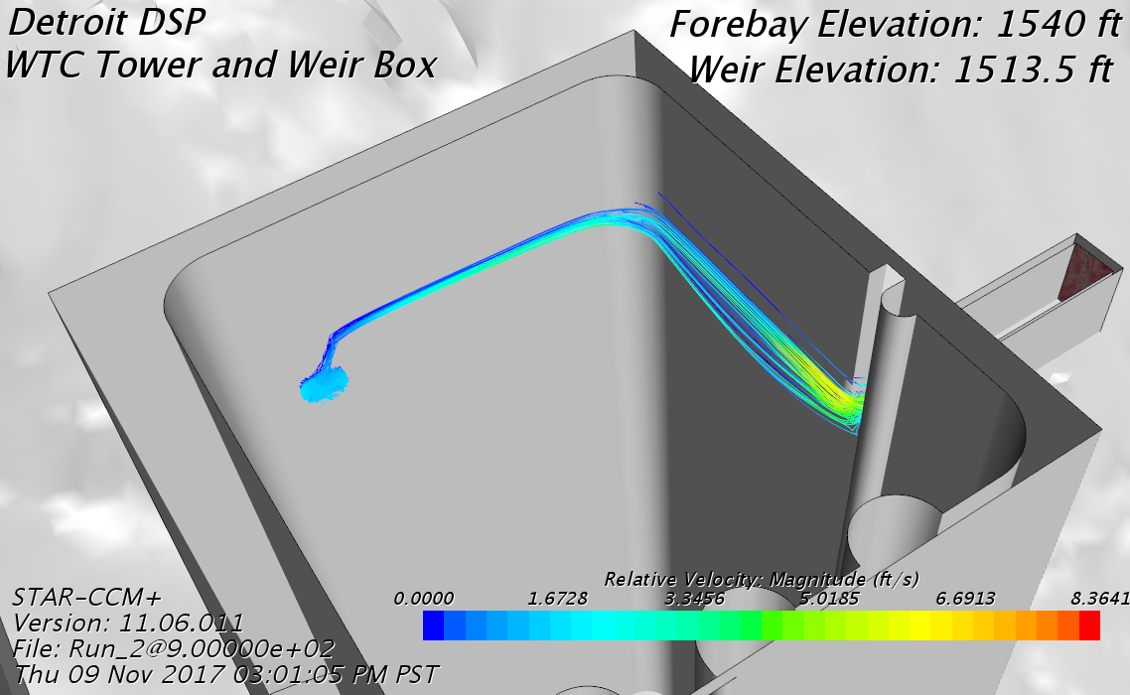
Water particles entering weir box

Slide 7
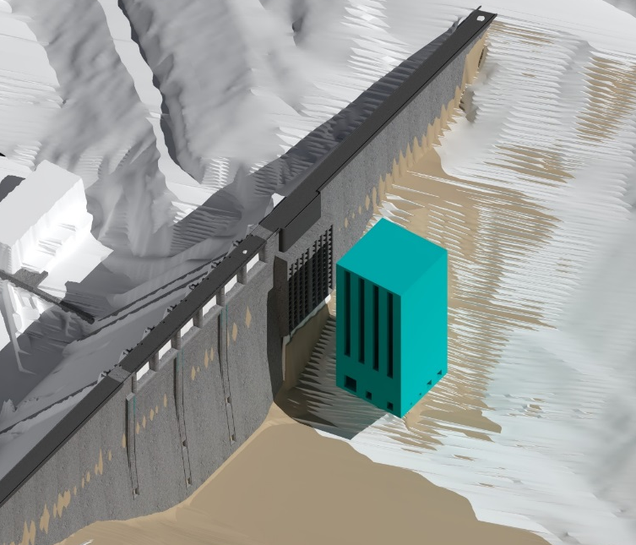
Weir Box Concerns/Risk
Compatibility – Weir Box and FSS
Optimum wet well entrance location
Weir box - facing south
FSS – facing east or north
Cost
Weir box alone - $10 mil
Wet well upgrades - $20 mil
FSS cost increase - $20 mil
Current trend
Likelihood of success is going down
Cost is going up
PDT recommendation – stop pursuing Weir Box

Slide 8
Project Schedule
Phase 1 (Selective Withdrawal Structure)
SWS DDR Complete – September 2018 (currently at 60%)
SWS P&S Complete – April 2020
SWS Construction Contract Award – Oct 2020
Phase 1 Complete – 2023
Phase 2 (Floating Screen Structure)
FSS DDR Complete – November 2018 (currently at 10%)
Revised FSS DDR complete - 2023 (Incorporates lessons learned)
FSS P&S complete – 2025
FSS Construction Contract Award – 2025
Phase 2 Complete – 2028

Slide 9
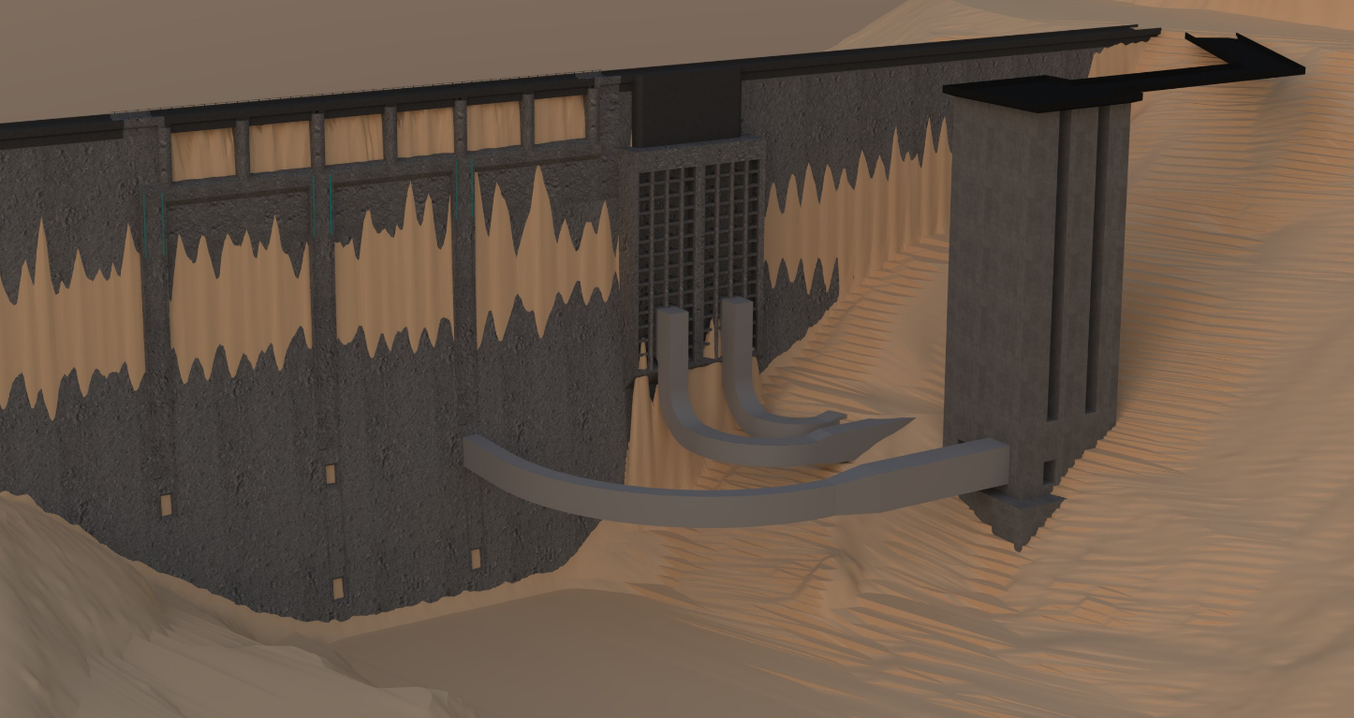
SWS – current isometric (as of 20 Dec 2017)

Slide 10
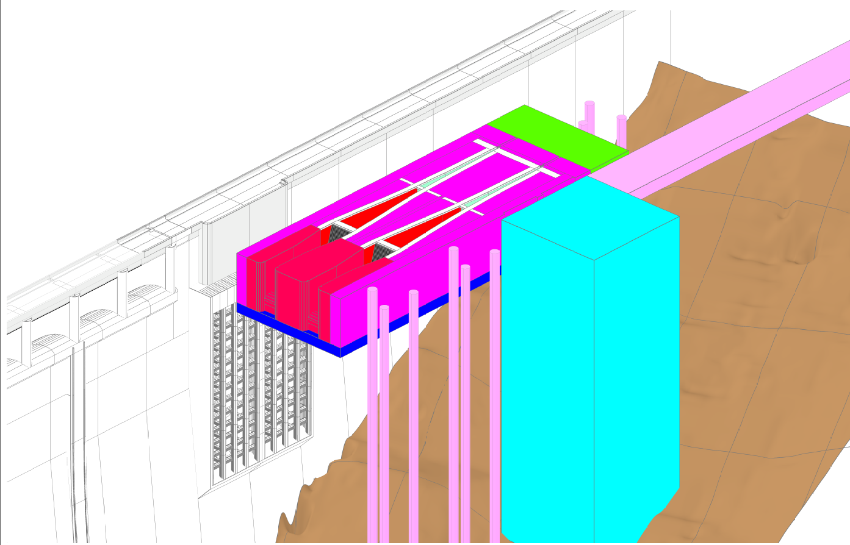
SWS and FSS - isometric

Slide 11
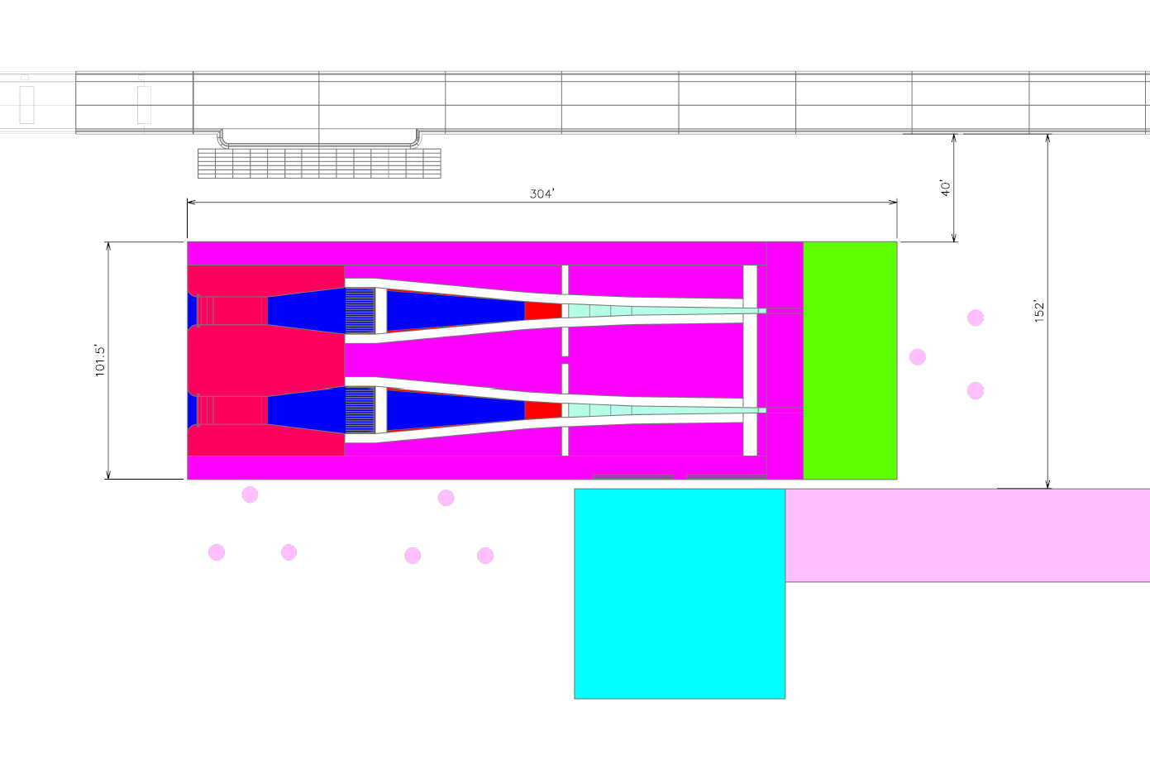
SWS and FSS - plan
DAM
FSS
Bridge
SWS

Slide 12
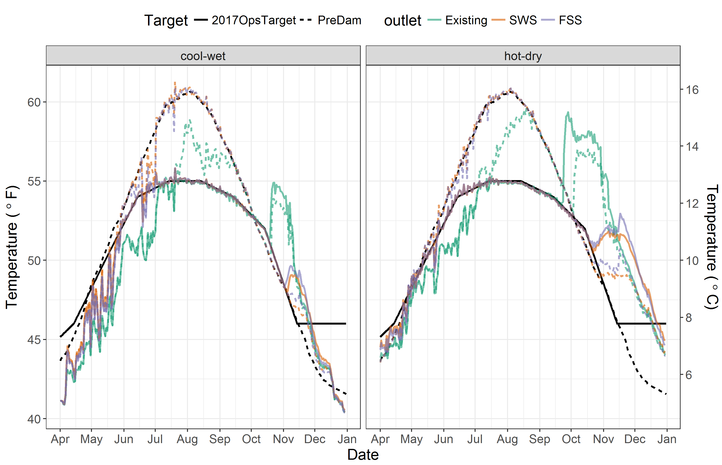
Temperature modeling
Model Results (colored lines)
Temperature target (black line) will affect downstream temperatures most in hot-dry years

Slide 13
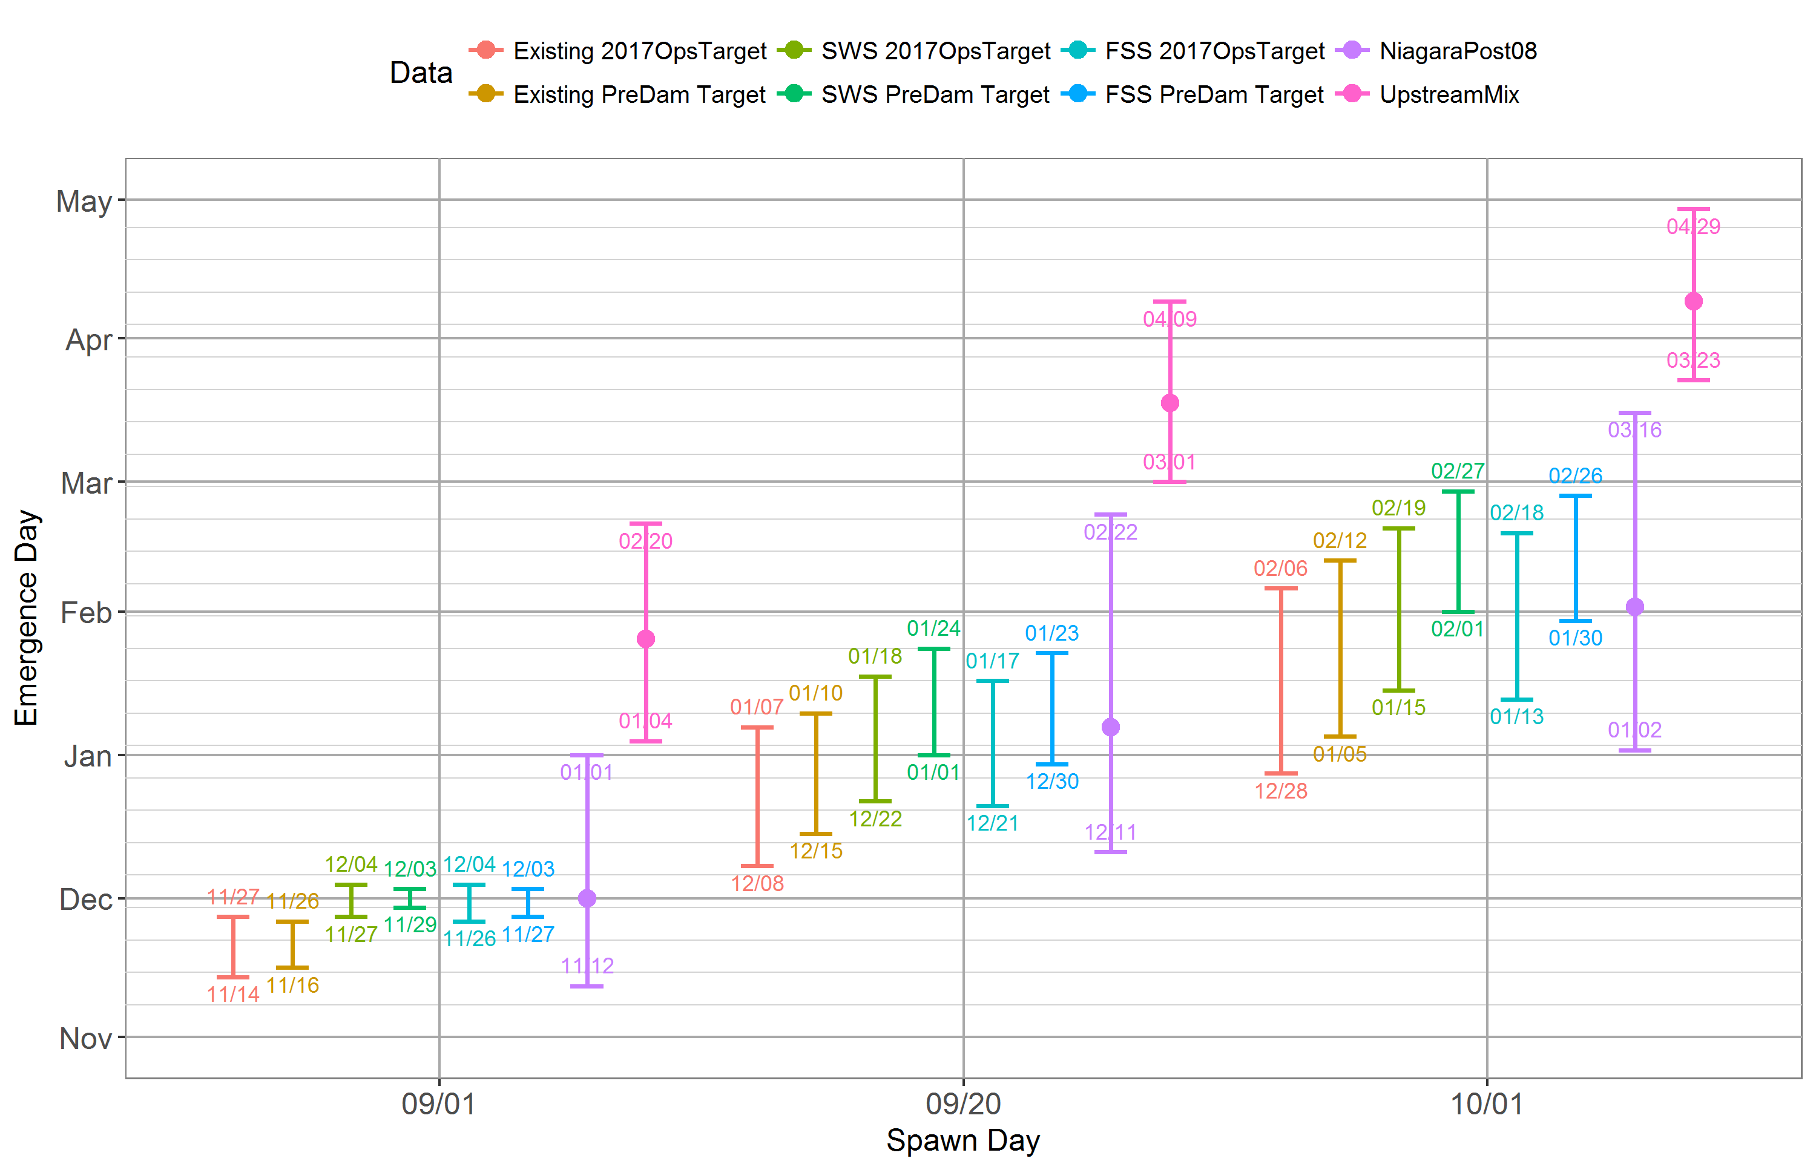
Temperature modeling
Compared to “Existing” conditions, egg emergence from peak spawners (Sep 20) was delayed about 2 weeks under FSS and SWS scenarios with PreDam temperature targets.

Slide 14
Biological considerations
Fish interaction with warm water and cold water gates
Design alignment with FSS
Trap and haul
Piped bypass
RM&E
Shaped weir test on east face SWS
Biological
RM&E???
Engineering

Slide 15
Hydraulic
SWS Flow Requirements
Maximum single RO discharge = 6525 cfs
Maximum combined turbine discharge = 5600 cfs
Warm Water Weirs operate from pools of 1425 – 1570 feet.
Maximum Surface inflow = 5,600 cfs (total turbine capacity)
2 x 20–ft wide weirs to receive flow from floating screen structure (FSS) on west face
Maximum head differential from the FSS to SWS = 0.5 feet.
Estimated differential from forebay to SWS wet well is 4 – 6 feet.
2 x 10–ft wide weirs to receive bypass flow around FSS on east face
Design bypass flow head differential from the forebay to SWS = 2 feet.

Slide 16
Hydraulic
The low level inlets are sized for up to 5,920 cfs (with one gate redundancy).
4 x 10-ft wide x 15-ft high inlet gates, RO gate lip design.
Gate invert = 1327 feet.
Low level gates will operate via PLC to prevent excessive drawdown in tower
The total combined SWS discharge is 11,500 cfs.
Maximum design head differential from Forebay to SWS wet well = 12 feet.
Conduits under FSS operations:
Estimated head differential from forebay to existing penstock intakes is 5 -10 feet.
Estimated head differential from forebay to existing RO intake is 4 -11 feet.

Slide 17
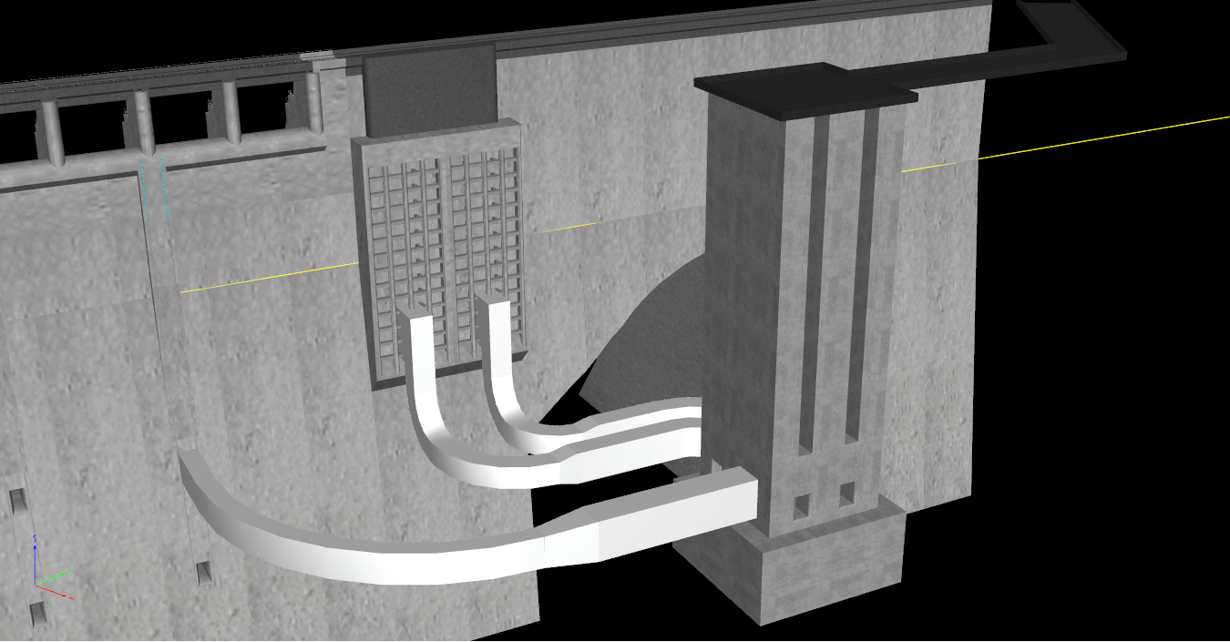
Structural
ACCESS BRIDGE
WARM WATER INTAKES
(BYPASS)
PENSTOCK CONDUITS
COLD WATER INTAKES
R.O. CONDUIT
N

Slide 18
Structural
Selective Withdrawal Structure
80’x80’x259’ tall reinforced concrete structure w/ open wet well
Foundation Concepts:
105’x105’x50’ mass concrete mat foundation socketed into bedrock
(20) 48” diameter reinforced concrete drilled shafts around perimeter
Access Bridge
Precast, prestressed concrete bridge girders — Piers may be as high as 200 ft tall.
N

Slide 19
Structural
Warm Water Intake Gates
(2) 20 ft W x 157.5 ft H telescoping weir gates as primary on west wall
(2) 10 ft W x 157.5 ft H telescoping weir gates as bypass on east wall
Each telescoping weir gate is made up of (3) leafs.
Cold Water Intake Gates
(2) on south wall; (2) on east wall
All gates are 10 ft W x 15 ft H vertical lift gates
Regulating Outlet Conduits
20 ft W x 26 ft H → 12 ft W x 20 ft H
Penstock Conduits
15 ft W x 21 ft H → 15 ft W x 15 ft H
N

Slide 20
Mechanical
WWIGs - one hoist to lift all three leaves. Hoists are wire rope with electric motor, gearbox, and spiral wound wire rope drum.
CWIGs hoist under consideration: wire rope hoist and a hybrid wire rope (hydraulic cylinder and wire rope).
Pressure activated pressure relief panels incorporated into CWIG to provide emergency pressure relief.
RO and Penstock conduit bulkhead hoists similar in design to the WWIG hoist.
Gantry/Bridge crane is above hoists and has full coverage of SWS deck.
FSS Fish Hopper crane is on SWS approach bridge.

Slide 21
electrical
Criteria:
Supply sufficient power to operate gates and ancillary equipment at SWS.
Provide spare capacity to power future FSS.
Include the ability for local and remote control/monitoring of various equipment and instrumentation.
Provide automated controls where required by water level changes, forebay/wet well differential, generator operation, etc.
Design Discussion:
Electrical loads are still being determined for both SWS and FSS. The FSS will have a significant power need (estimated between 1MW and 4MW).
Location of the SWS substation and electrical equipment is in progress.
A new dedicated PLC will be provided at the SWS.

Slide 22
Construction alternatives
Two Summer Drawdown
Lower the pool to 1310 for about 21 months.
Best option for constructability
In-the-wet
No deviation from rule curve
Best option for recreation
One Summer Drawdown
Provide about 9 months of dry conditions at El 1310
Only the excavation and foundation could be completed in the dry
Concepts that are not feasible
Cofferdam
Building in the dry without impacting summer recreation

Slide 23
Construction challenges
Drawdown:
Recreation at Detroit Lake
Detroit Lake Recreation Committee
Has the attention of Federal and State politicians
Publics meetings were held in Dec and Jan.
About 110,000 people visit Mongold each year, 75% of which is in the summer
Water supply: Salem, Stayton
Water quality
900 CFS min flow required to operate Minto.
In the Wet:
Is it constructible?
Tremie placed concrete will not work for precise placement
Float in concrete is risky and complicated
Tolerances of the gate slots
Large amount of excavation at 100-250 feet of water depth

Slide 24
VE Study
VE study conducted 8-12 January
VE team focused on constructability
PDT is analyzing alternatives

Slide 25
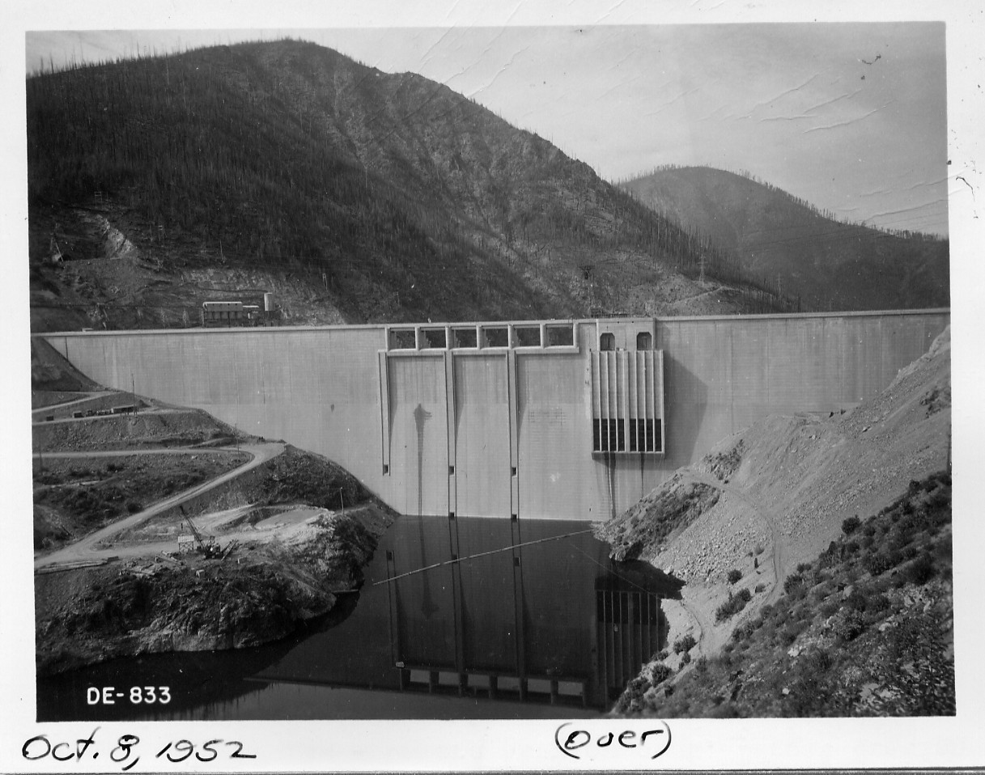
Questions

